Slide 1

EDA CASE STUDY
HARISH J

Slide 2

PROBLEM STATEMENT
IN THIS CASE STUDY WE ARE HELPING THE BANKS TO UNDERSTAND THE DRIVING FACTORS (OR DRIVER VARIABLES) BEHIND LOAN DEFAULT, I.E. THE VARIABLES/FACTORS WHICH ARE STRONG INDICATORS THAT AN APPLICANT IS MORE LIKELY TO BE A DEFAULTER.

Slide 3
CONTINOUS UNIVARIATE ANALYSIS

Slide 4
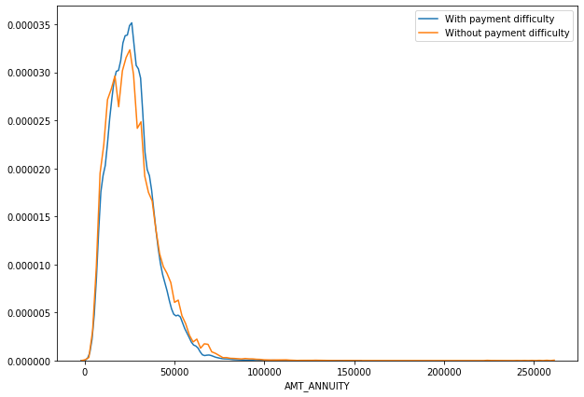
Points to be concluded from the
graph.
We can observe that the loan annuity for both categories of Target audience appears to be similar
Most of the people with payment difficulty have annuity of around 25000

Slide 5
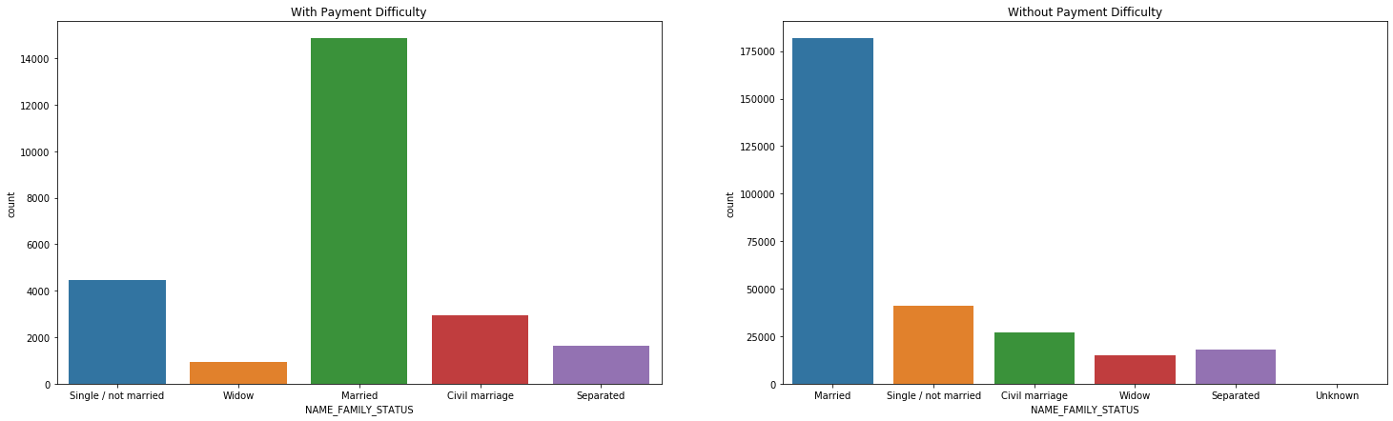
Points to be concluded from the
graph.
Number of married applicants is much higher as compared to others.

Slide 6
CATEGORICAL UNIVARIATE ANALYSIS

Slide 7
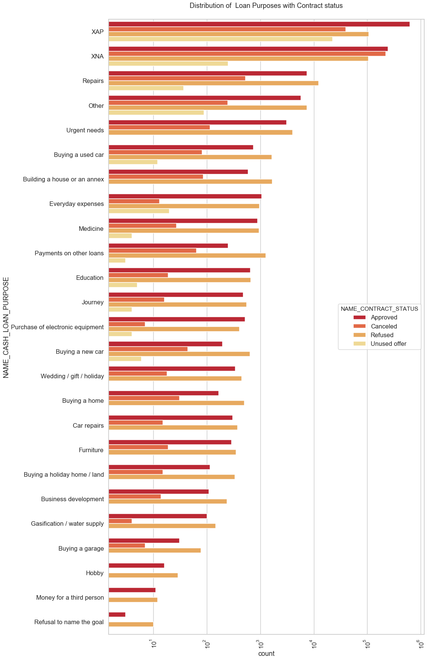
Points to be concluded from the graph.
Most rejection of loans came from purpose 'Repairs'.
For Payment on other loans and Buying a new car have significantly higher rejection ratio than approved.
For Education loan the ratio of Approval and rejection is almost same.

Slide 8
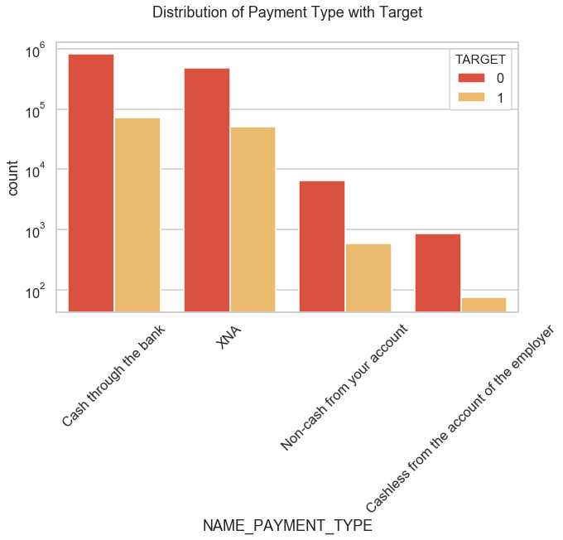
Points to be concluded from the
graph.
Applicants with Payment type as 'Cash through the bank' are facing the most difficulties with payment.
Also applicants with Payment type ' Cashless from the account of the employer' face the least difficulty with payment.

Slide 9
BIVARIATE ANALYSIS

Slide 10
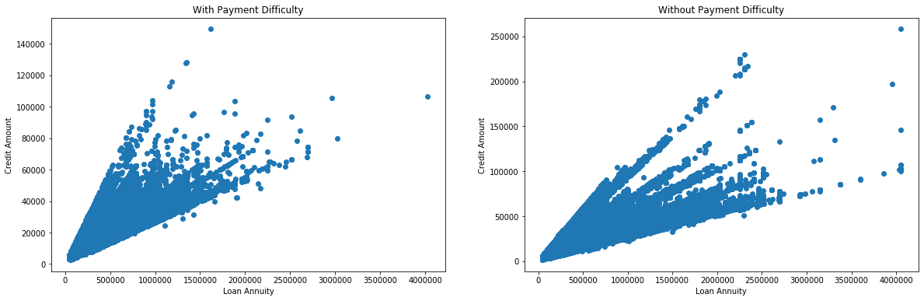
CONTINOUS - BIVARIATE ANALYSIS
Points to be concluded from the graph.
Number of people with Loan Annuity more the 25 Lacs is much more for people without payment difficulties.
We can also observe, in case of Credit Amount, there are no applicants with credit amount above 150000 for people having payment difficulty.

Slide 11
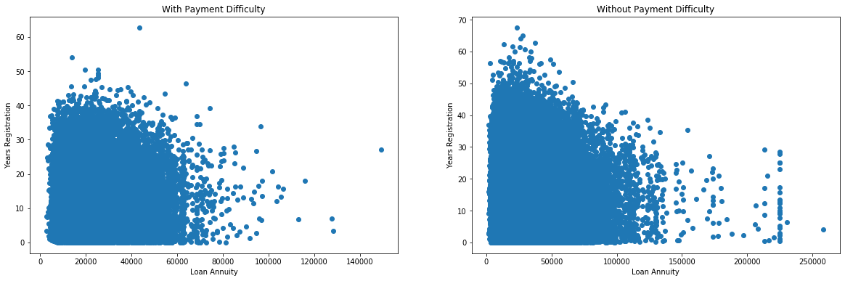
CONTINOUS - BIVARIATE ANALYSIS
Points to be concluded from the graph.
There are significantly more applicants with Loan Annuity above 150000 for the people without payment difficulty.
There are very few applicants having years registration more than 50 with payment difficulty

Slide 12
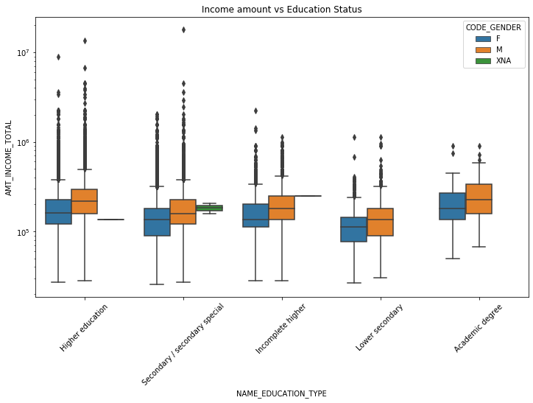
CONTINOUS vs CATEGORICAL - BIVARIATE ANALYSIS
Points to be concluded from the
graph.
Males from all Education type
have higher mean Annual salary.
Higher Education and Secondary/ Secondary special contain many outliers.
Females with Education level Lower secondary have less Annual Income than others.

Slide 13
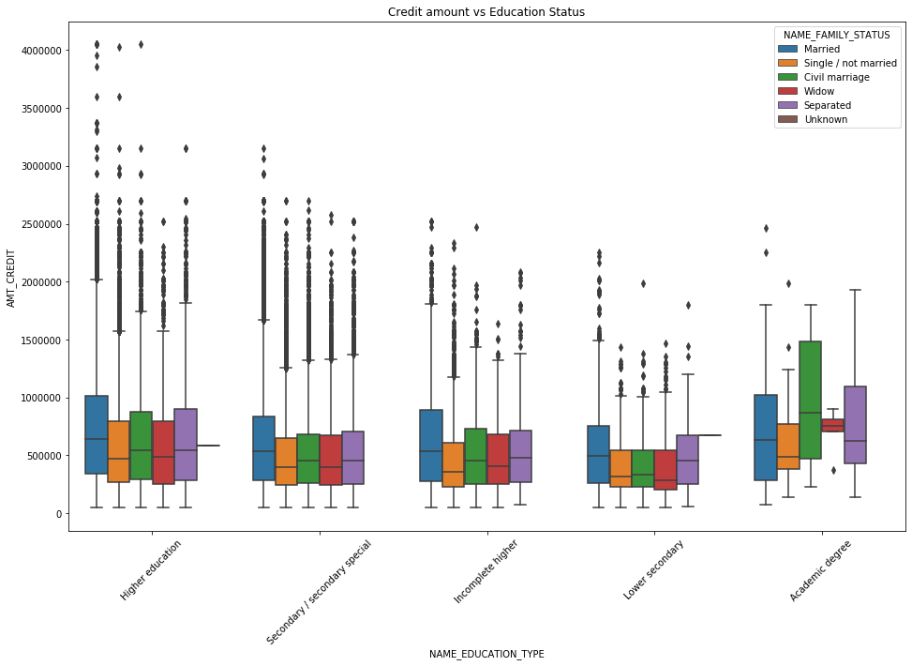
CONTINOUS vs CATEGORICAL - BIVARIATE ANALYSIS FOR TARGET - 0
Points to be concluded from the
graph.
For the applicants, without having difficulty with payment, of all the Marriage types with Academic degree education the Credit amount is higher than others.
Higher education category is
having more outliers.

Slide 14
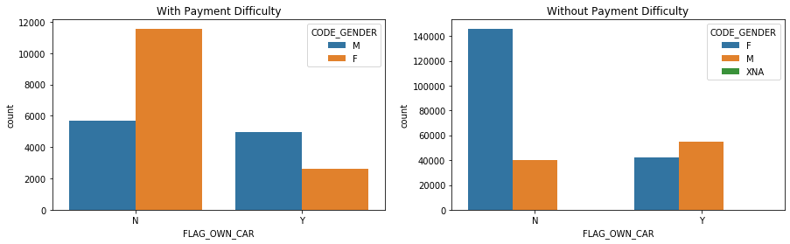
CATEGORICAL - BIVARIATE ANALYSIS
Points to be concluded from the graph.
Number of Females owning a car
is less in both cases.
Number of Males without payment difficulty and having a car is more than those not having a car.
In case of Males with payment difficulty, number of them having a car is less than males not having a car.

Slide 15
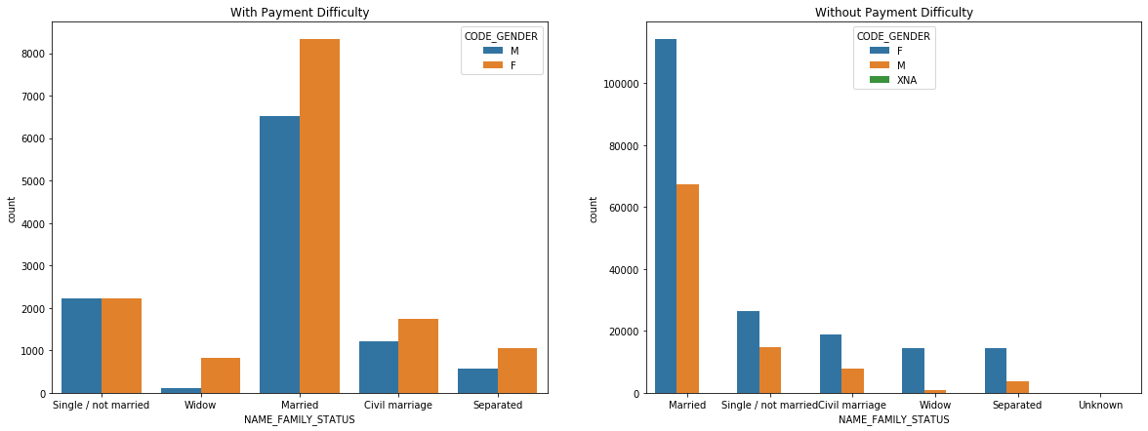
CATEGORICAL - BIVARIATE ANALYSIS
Points to be concluded from the graph.
More number of Married Female applicants faced Payment difficulties.
The ratio of males and female Single applicants is almost equal for payment difficulty, whereas the ratio of Female applicants is more than males for no payment difficulty.

Slide 16
CORRELATION ANALYSIS

Slide 17

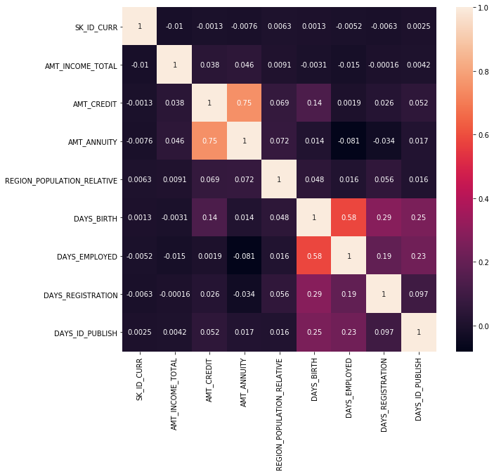
CORRELATION FOR TARGET-1

Slide 18
CORRELATION FOR TARGET-1
Points to be concluded from heatmap.
We can observe that AMT_ANNUITY and AMT_CREDIT have the highest Correlation.
Also DAYS_EMPLOYED and AMT_ANNUITY are inversely correlated.

Slide 19
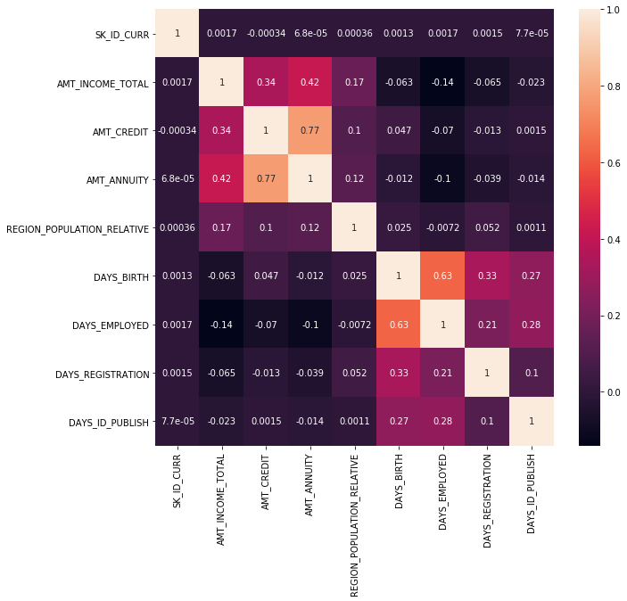
CORRELATION FOR TARGET-0

Slide 20
CORRELATION FOR TARGET-0
Points to be concluded from heatmap.
Here also AMT_ANNUITY and AMT_CREDIT have the highest correlation
Also DAYS_EMPLOYED and AMT_INCOME_TOTAL are inversely correlated.

Slide 21
CONCLUSION
Try to avoid applicants having loan purpose as 'Repairs' as they are facing more difficulties with repayment.
Try to avoid Repeater and Refreshed applicants as they faced the most difficulty with the payments.
Try to avoid applicants staying in Office apartment and Co-op apartment as they face the most difficulty in
repayment.
Banks should focus on Applicants having house type 'With Parents' since they are the most successful with repayment.
Banks should focus more on Students and commercial associate applicants as they have comparatively less
payment difficulty.

Slide 22
THANK YOU

